Slide 1
Kelsey-White Inc.
Update – Blue Brand Operational and Data-Driven Support
October 2020
HRR Group

Slide 2
Agenda
Project Goals
Key Findings
Preliminary Recommendations
Deck structure from USPS book examples, Matt’s deck
Visuals from book (e.g. no pie charts)

Slide 3
Project Goals

Slide 4
Project Goals
Increase Blue Detergent market share over the next four years
Increase Blue Detergent profitability over the net four years
Enhance K-W Vision platform to increase usage and data-driven decision-making by K-W managers

Slide 5
Key Findings

Slide 6
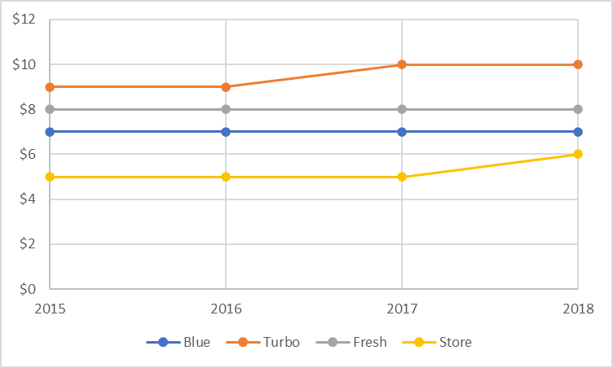
Turbo and Store recently increased price

Slide 7
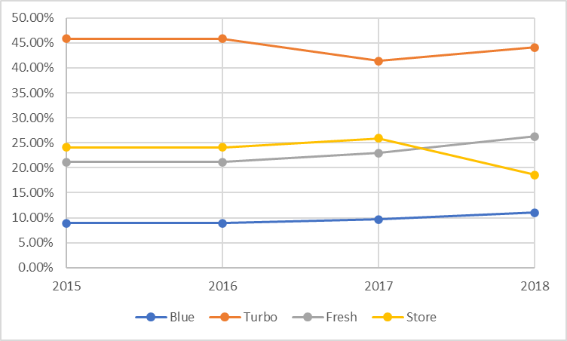
Price increases directly led to decreasing market share

Slide 8
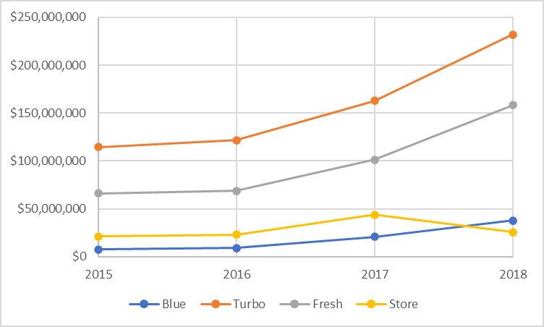
Operating profit growing for Blue but slower than Turbo and Fresh

Slide 9
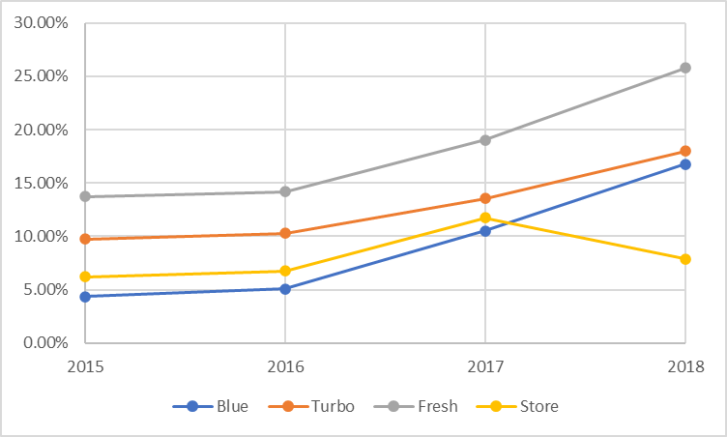
Profit margin % near Turbo, but lags Fresh

Slide 10
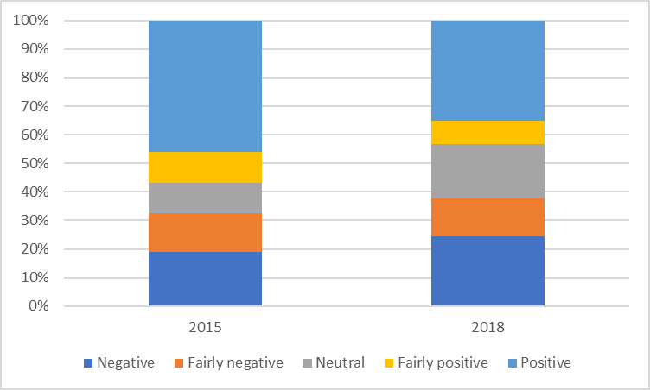
Blue social media is trending negative
Notes:
Marketing, effectiveness, and scent/reaction

Slide 11
Other observations
Predict demand and set production
Pricing?
Formulation?
Promotional spending?
Trade channel: higher income buyers likely to purchase at Grocery or Mass
K-W Vison?:
Exporting capability for analysis
Multivariate regression, etc. for optimization
Hiring/onboarding, training, change management for data-drive culture

Slide 12
Recommendations

Slide 13
Preliminary Recommendations
Predict demand and set production
Pricing?
Formulation?
Promotional spending?
Communicate strategy to managers?
K-W Vison?

